Slide 1

DATA SCIENCE
10 WEEK PART TIME COURSE
Week 1 Lab - Git

Slide 2
AGENDA
Introduction
Exploring GitHub
Using Git with GitHub
Contributing on GitHub
Bonus Content

Slide 3
WHY LEARN GIT (OR ANY VERSION CONTROL)?
Attractive skill for employment
How we’ll do assessments and submissions at GA
Version control is useful when you write code, and data scientists write code
Enables teams to easily collaborate on the same codebase
Enables you to contribute to open source projects
You’ll never lose anything again

Slide 4

WHAT IS GIT?
Version control system that allows you to track files and file changes in a repository (“repo”)
Primarily used by software developers
Most widely used version control system
Alternatives: Mercurial, Subversion, CVS
Runs from the command line (usually)
Can be used alone or in a team

Slide 5

WHAT IS GITHUB?
Allows you to put your Git repos online
Largest code host in the world
Alternative: Bitbucket
Benefits of GitHub:
Backup of files
Visual interface for navigating repos
Makes repo collaboration easy
Git does not require GitHub

Slide 6
LEARNING GIT
Designed (by programmers) for power and flexibility over simplicity
Hard to know if what you did was right
Hard to explore since most actions are “permanent” (in a sense) and can have serious consequences
We’ll focus on the most important 10% of Git

Slide 7
GITHUB SETUP
Create an account at github.com
There’s nothing to install “GitHub for Windows” & “GitHub for Mac” are GUI clients (alternatives to command line)

Slide 8
NAVIGATING A GITHUB REPO (1 of 2)
Example repo: https://github.com/solresol/SYD_DAT_5
Account name, repo name, description
Folder structure
Viewing files:
Rendered view (with syntax highlighting)
Raw view
README.md:
Describes a repo
Automatically displayed
Written in Markdown

Slide 9
NAVIGATING A GITHUB REPO (2 of 2)
Commits:
One or more changes to one or more files
Revision highlighting
Commit comments are required
Most recent commit comment shown by filename

Slide 10
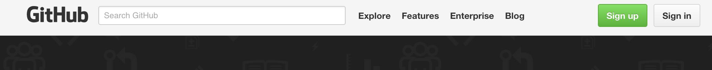
SIGNUP
Click on the signup button on the top-right
Choose a plan (one of them is free)
Remember your email and password!!!!

Slide 11
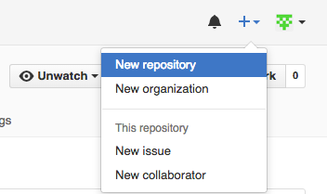
CREATING A REPO ON GITHUB
Click “Create New” (plus sign) on your profile:
Define name, description, public or private
Initialise with README (if you’re going to clone)
Notes:
Nothing has happened to your local computer
Done on GitHub which used Git to add the README.md file

Slide 12
MARKDOWN
Easy-to-read, easy-to-write markup language
Valid HTML can also be used within Markdown
Many implementations (aka “flavors”)
Let’s edit README.md using GitHub!
Common syntax:
## Header size 2
*italics* and **bold**
[link to GitHub](https://github.com)
* bullet
`inline code` and ```code blocks```

Slide 13
GIT INSTALLATION AND CONFIG
Installation: goo.gl/MJXSXp
Open Git Bash (Windows) or Terminal (Mac/Linux):
git config --global user.name “YOUR FULL NAME”
git config --global user.email “YOUR EMAIL”
Use the same email address you used with your GitHub account
Generate SSH keys (optional): goo.gl/xtH0jJ
More secure than HTTPS
Only necessary if HTTPS doesn’t work for you

Slide 14
PREVIEW OF WHAT WE ARE ABOUT TO DO
Copy your new GitHub repo to your computer - clone
Make some file changes locally
Save those changes locally - commit
Update your GitHub repo with those changes - push

Slide 15
CLONE
Cloning == copying to your local computer
Like copying your Dropbox files to a new machine
First, change your working directory to where you want the repo you created to be stored: cd
Then, clone the repo: git clone <URL>
Get HTTPS or SSH URL from your GitHub (ends in .git)
Clones to a subdirectory of the working directory
No visual feedback when you type your password
Navigate to the repo (cd) then list the files (ls)

Slide 16
CHECKING REMOTES
A “remote alias” is a reference to a repo not on your local computer
Like a connection to your Dropbox account
View remotes: git remote -v
“origin” remote was set up by “git clone”
Note: Remotes are repo-specific

Slide 17
MAKING CHANGES AND CHECKING STATUS
Making changes:
Modify README.md in any text editor
Create a new file: touch <filename>
Check your status:
git status
File statuses (possibly color-coded):
Untracked (red)
Tracked and modified (red)
Staged for committing (green)
Committed

Slide 18
COMMIT
Stage changes for committing:
Add a single file: git add <filename>
Add all “red” files: git add .
Check your status:
Red files have turned green
Commit changes:
git commit -m “message about commit”
Check your status again!
Check the log: git log

Slide 19
RECAP OF WHAT WE’VE DONE
Created a repo on GitHub
Cloned repo to your local computer - git clone
Automatically sets up your “origin” remote
Made two file changes
Staged changes for committing - git add
Committed changes - git commit
Pushed changes to GitHub - git push
Inspected along the way - git remote, git status, git log

Slide 20
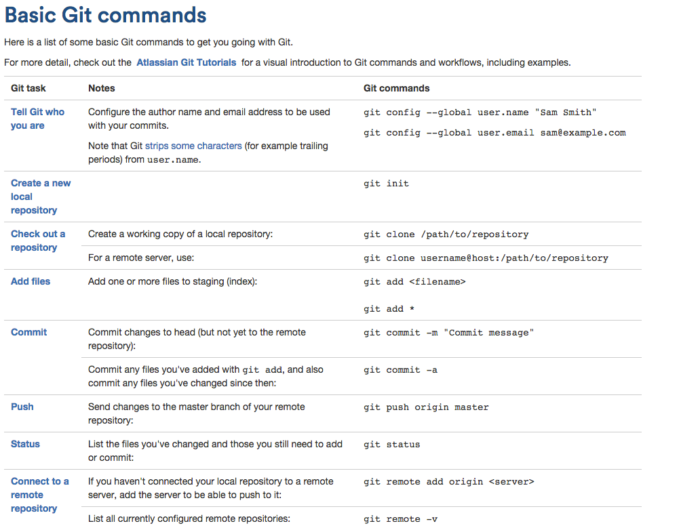

Slide 21
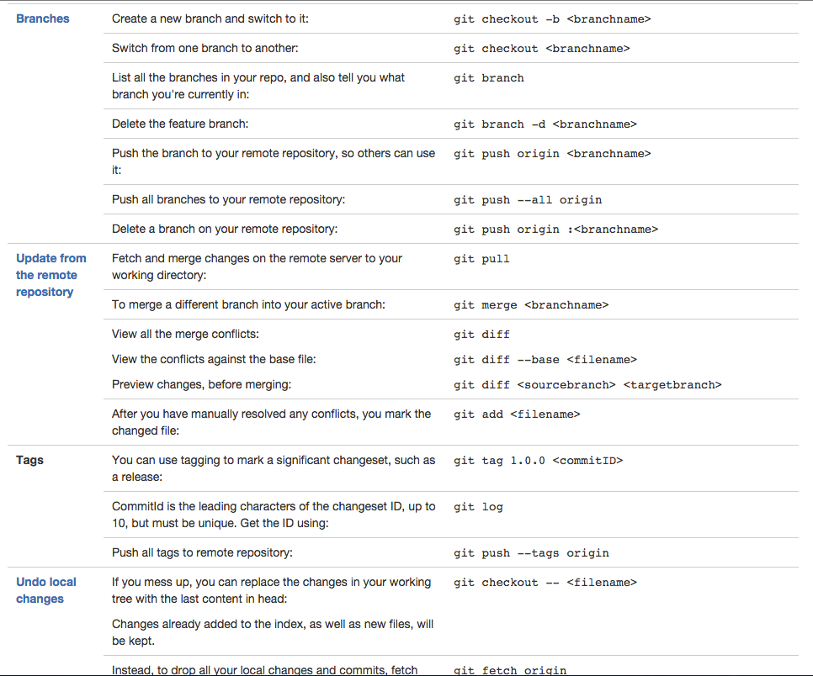

Slide 22
